Slide 1
Developing Context-Aware Coding Assistants for Clinical Data Analysis
Steven Brooks & Xiecheng Gu

Slide 2

Vision
Needed features:
Data security and compliance
No-code data analysis
Generates R code
Understand data standards
Utilize documentation
Simple and easy interface

Slide 3
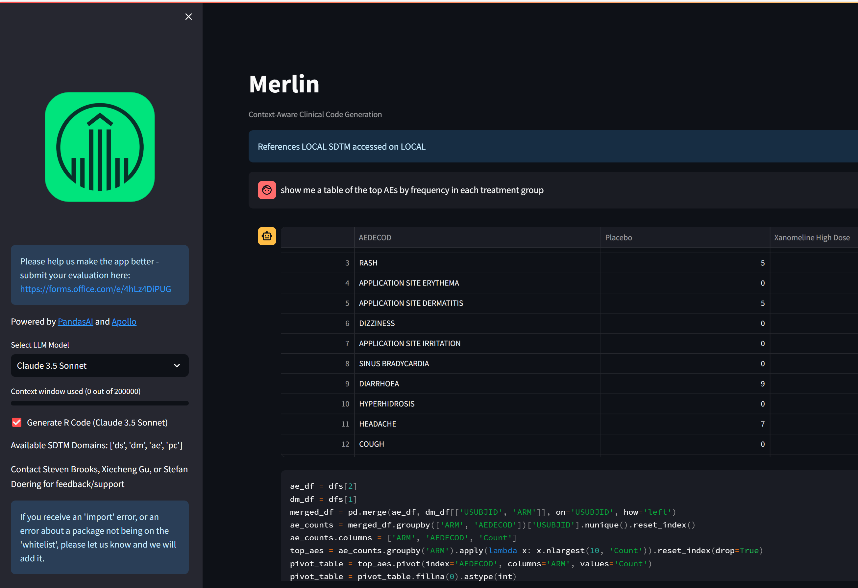
Solution #1: PandasAI Agent
Features:
PandasAI is an open-source project that provides no-code data analysis through LLMs using python.
Knowledge of internal data standards.
Added an “R translator”
All internal – nothing leaves the company intranet.
Limitations:
Code is executed in python
No access to documentation
Fragile to user input and LLM performance
Maintain separate app for each trial

Slide 4
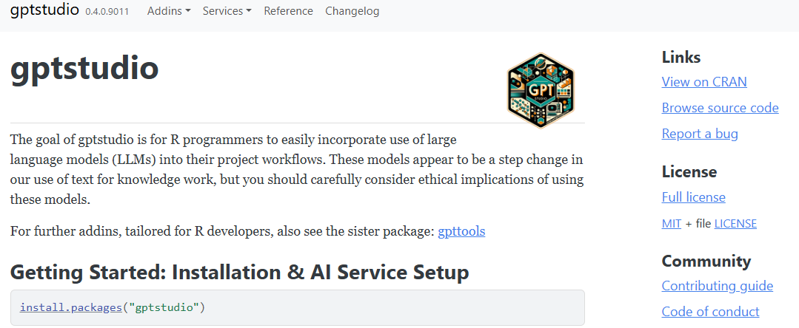
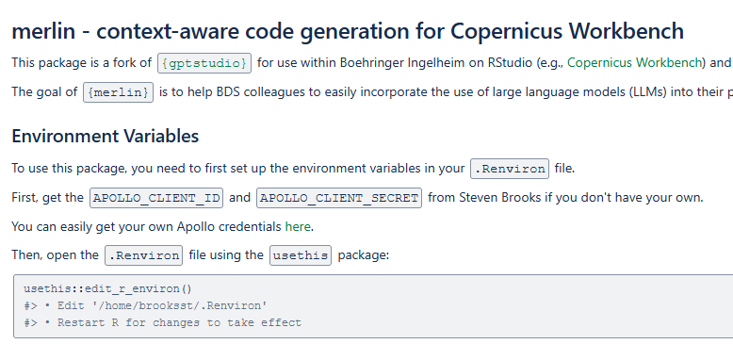
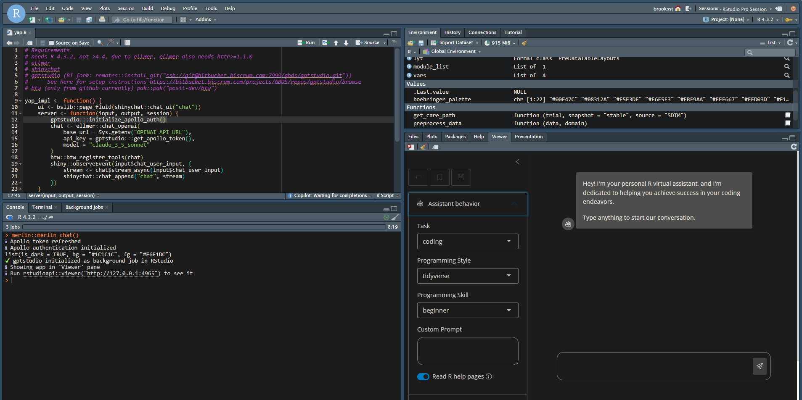
Solution #2: {gptstudio} RStudio Chatbot
Features:
Access to R package documentation with “pkg::func”
Customizable for different users
Integrated into development environment
Easy to maintain and deploy
Limitations:
No code execution -> more bugs
No access to R environment/data
Boehringer fork

Slide 5
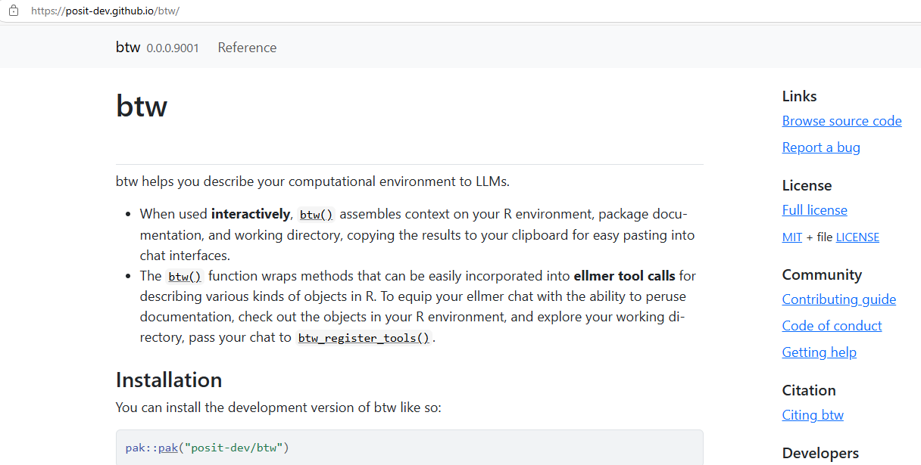
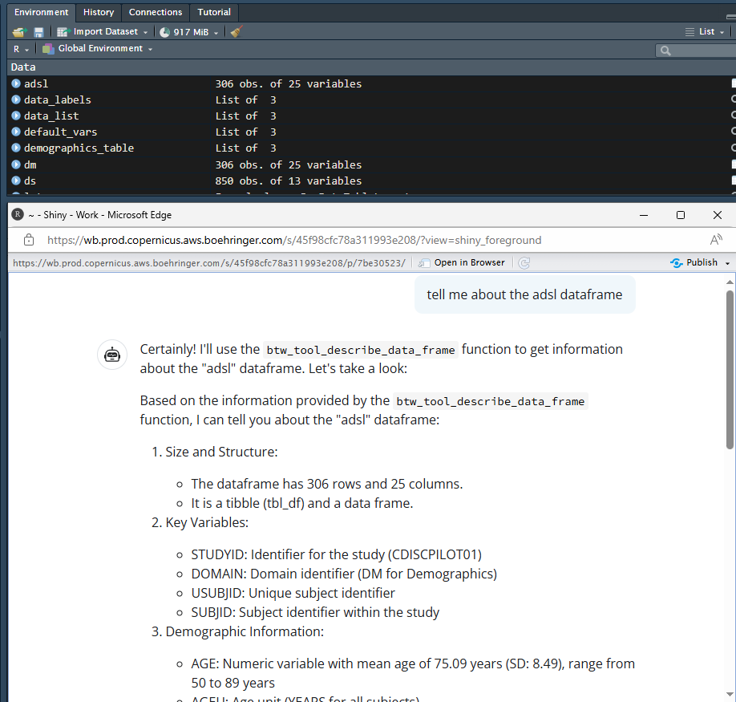
Solution #3: {btw} RStudio Agent
Features:
Access to R environment/data.frames
Access to package documentation
Can execute R code
Limitations:
Inconvenient workflow for users
{btw} still very experimental (4 months old)
Requires more development to make user-friendly

Slide 6

Summary of Solutions
 | Solutions
Requirements | PandasAI | {gptstudio} | {btw}
Data security
Compliance
No-code analytics | ✓ | ✗ | ✓
Generates R code | ✗ | ✓ | ✓
Data standards | ✓ | ✗ | ✗
Reference pkg docs | ✗ | ✓ | ✓
IDE integration | ✗ | ✓ | ✓
Runs in background | - | ✓ | ✗

